Slide 1
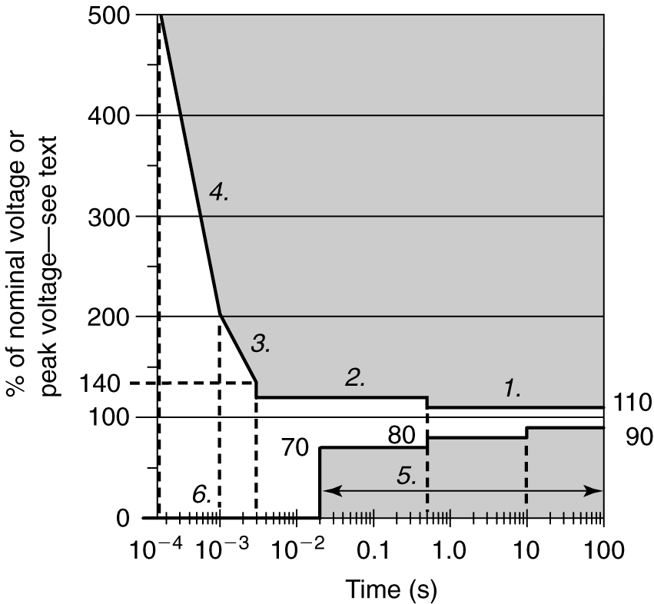
CBEMA Tolerance Curve

Slide 2
Region 1: Steady-State Tolerances
Long-duration voltage changes
+10% Overvoltage & -10% Undervoltage

Slide 3
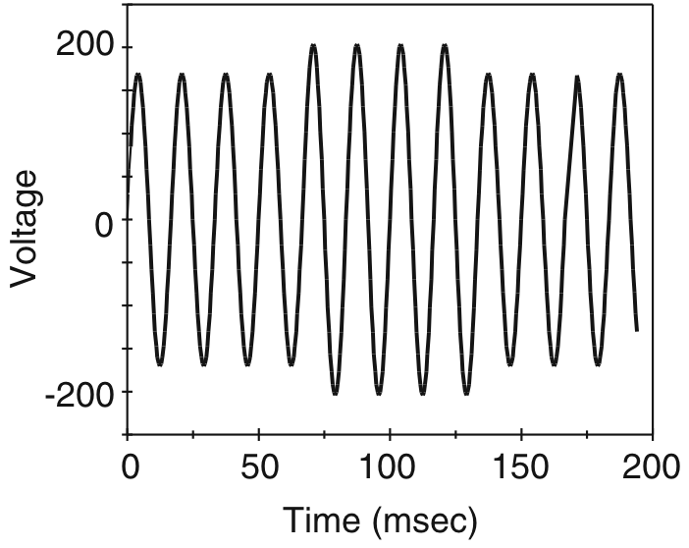
Region 2: Line Voltage Swells

Slide 4
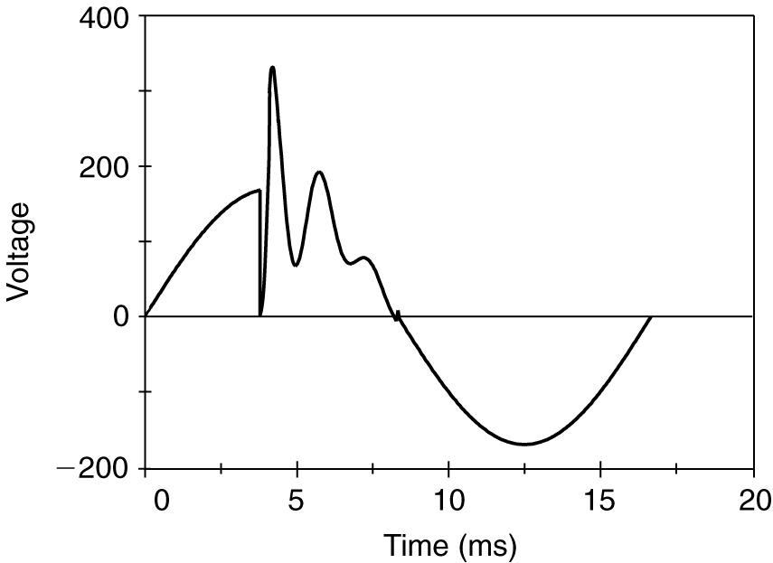
Region 3: Surges and Low-Frequency Transients

Slide 5
Region 4: High-Frequency Transients

Slide 6
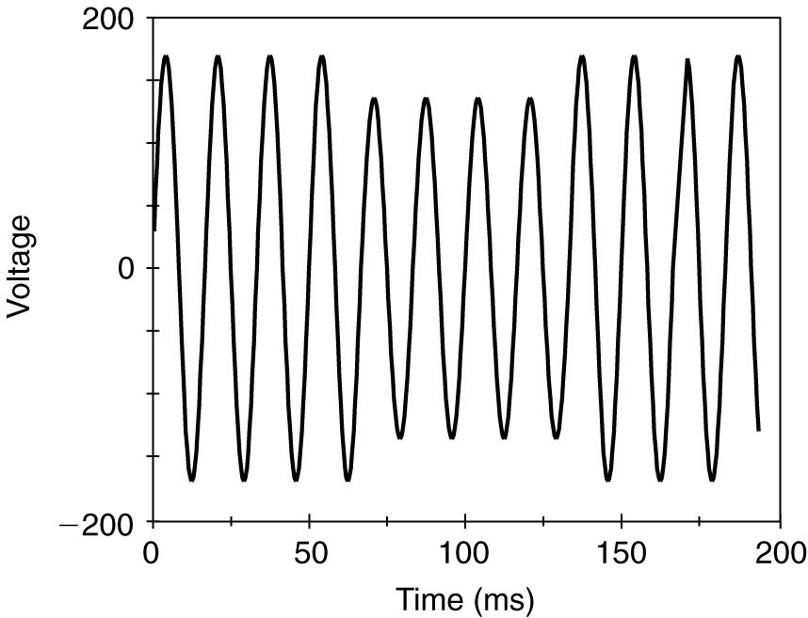
Region 5: Voltage Sags

Slide 7
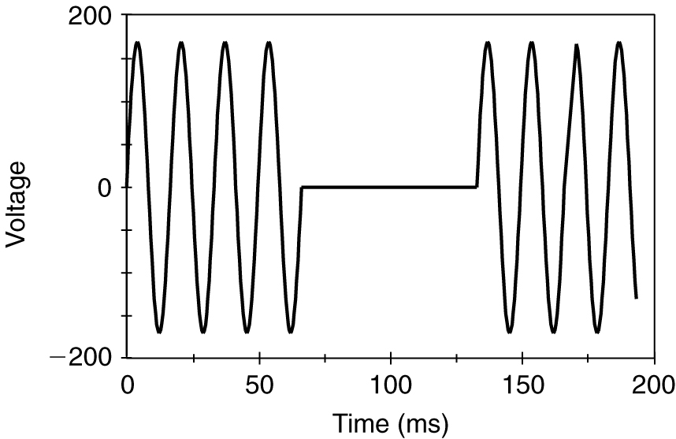
Region 6: Voltage Interruptions

Slide 8
Other Regions
Prohibited Region
No-damage Region

